Slide 1
Biomedical Imaging Nuclear Imaging (II)
Sebastian Kozerke / Markus Rudin
Institute for Biomedical Engineering, University and ETH Zurich, Switzerland

Slide 2
Today’s Learning Objectives
Explain various PET coincidence events and corrections thereof
Describe SPECT radioisotope production (Technetium generator)
Describe PET radioisotope production (cyclotron)
Derive basic kinetic models for PET tracer quantification
Implement kinetic modeling for PET (Exercise)
2
2

Slide 3
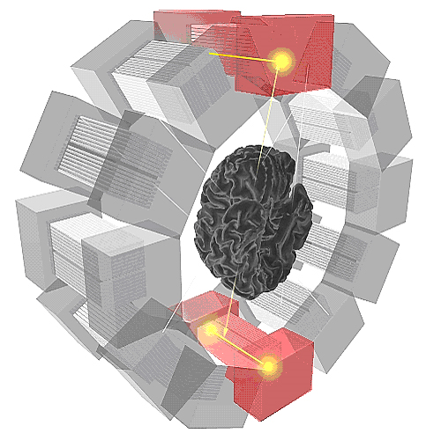
Positron Emission Tomography
γ(511 keV)
e⁻
e⁺
Positron
emitter
γ(511 keV)
Notes:
Registration of event:
Coincidence detection, i.e.
two events occuring within a
time window Dt attributed to
One anihilation event
| t1 - t2 | < Δt
Resolution:
- Positron lifetime -> 0.3-1 mm
Number of detectors and size of detector
Off-center position
Setting of Δt
colineraity

Slide 4

Activity (5 min)
Using the mass of positron/electron, show that the energy of γ-photons is indeed 511 keV (m_{p,e} = 9.11∙10⁻³¹ kg; 1 eV = 1.6 ∙10⁻¹⁹ J)!
γ(511 keV)
e⁻
e⁺
Positron
emitter
γ(511 keV)

Slide 5
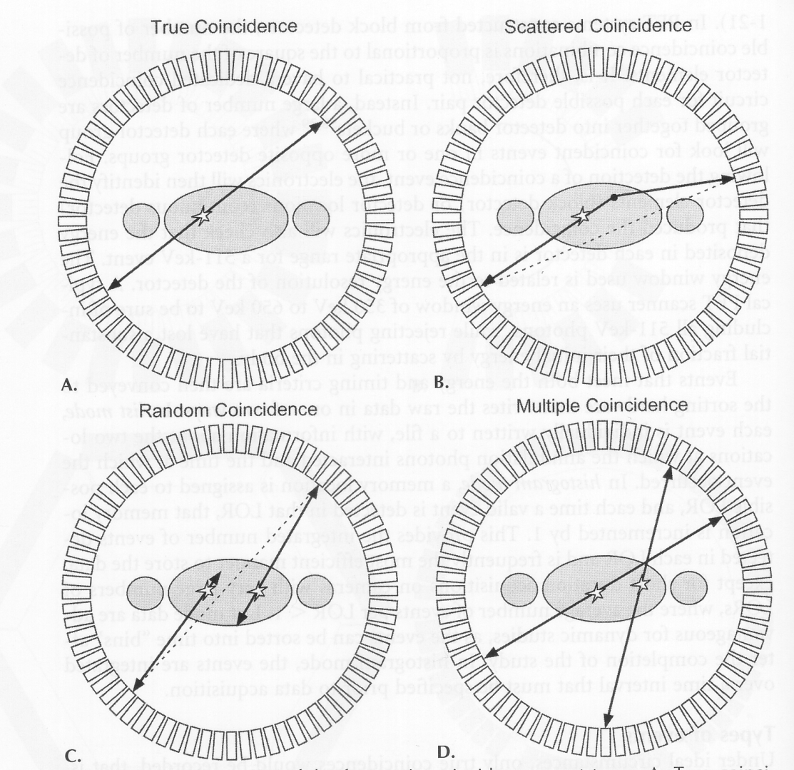
Coincidence types
Chapter 3.18
true coincidence
scattered coincidence
random coincidence
multiple coincidence

Slide 6
Coincidence detection
τ
A
A
B
threshold
B
A+B
Coincidence window 2τ

Slide 7
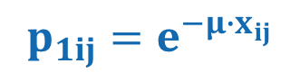

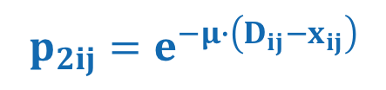
Attenuation correction
Chapter 3.18.1
Loss of γ-photons due to Compton scattering
$$p_{1ij}=e^{−μ∙x_{ij}}$$
D_{ij}-x_{ij}
x_{ij}
$$p_{2ij}=e^{−μ∙\left(D_{ij}−x_{ij}\right)}$$
Total scattering probability
$$p_{ij}=p_{1ij}∙p_{2ij}=e^{−μ∙D_{ij}}$$

Slide 8
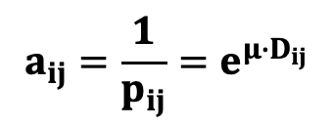
Attenuation correction
$$a_{ij}=\frac{1}{p_{ij}}=e^{μ∙D_{ij}}$$
i
i
μ
=
μ
D_{ij}
D_{ij}
j
j
internal PET source
external PET source

Slide 9
Coincidence types
true coincidence
scattered coincidence
random coincidence
multiple coincidence

Slide 10
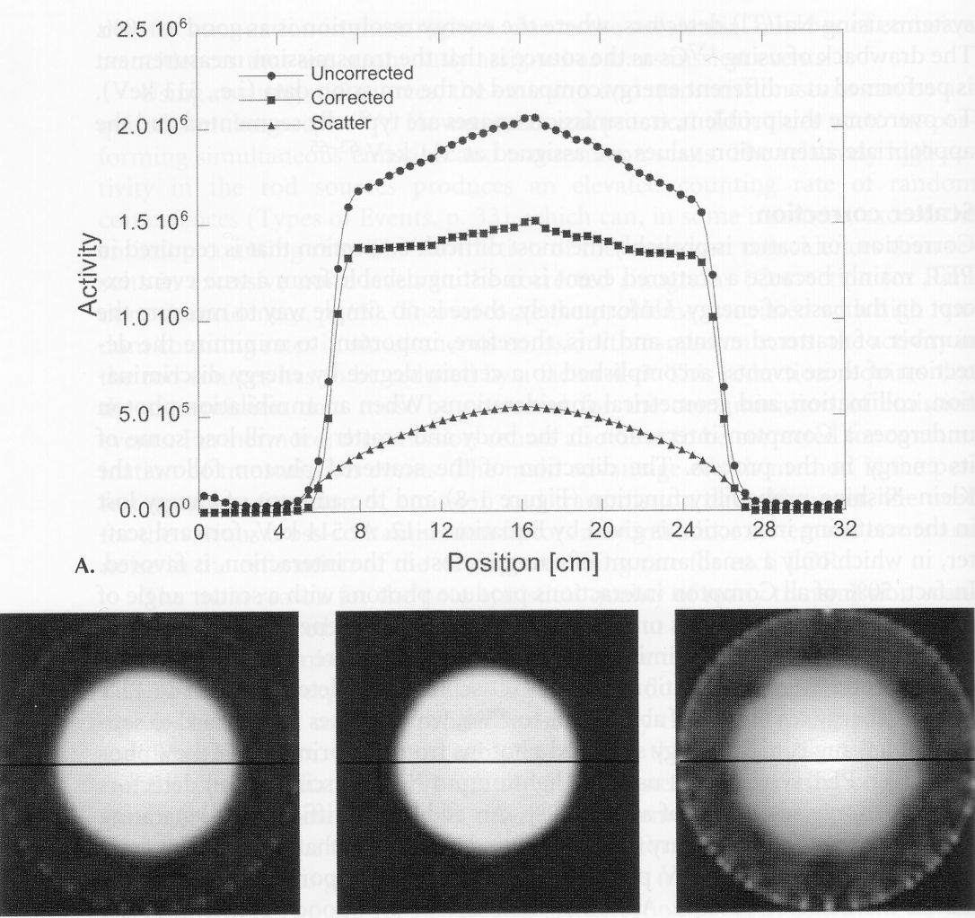
Scatter correction
Chapter 3.18.3
Analytical method
assumption: scatter distribution varies slowly across scattering medium
use phantom data to correct for scattered events
Dual energy method
Energy range 400-600 keV: scattered and true events
Energy range 200-400 keV: only scattered events
Simulation method
Reconstruction without scattering correction
Estimation of scattering correction

Slide 11
Coincidence types
true coincidence
scattered coincidence
random coincidence
multiple coincidence

Slide 12

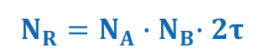
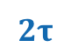
Random coincidences
Chapter 3.18.2
Frequency of random events
Individual photon detection rates of a pair of detectors:
Coincidence window:
Frequency of random events:
$$N_{A}{,N}_{B}$$
$$2τ$$
$$N_{R}{=N_{A}∙N}_{B}∙2τ$$
‚Randoms‘
no geometrical information
almost uniform distribution across field-of-view
→ reduced contrast-to-noise ratio
randoms

Slide 13
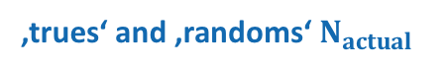


Correction of random coincidences
Estimate number of ,randoms’ for each detector pair: N₁, N₂, 2τ must be known
Measure/estimate number of ‚randoms‘ by adding parallel coincidence circuit
A
A
B
B
Coincidence window 1
Coincidence window 2
‚trues‘ and ‚randoms‘$N_{actual}$
‚randoms‘ $N_{randoms}$
Estimation of number of true events:
$$N_{true}{=N_{actual}−N}_{randoms}$$

Slide 14
Coincidence types
true coincidence
scattered coincidence
See random coincidence
random coincidence
multiple coincidence

Slide 15

Dead time correction
Chapter 3.18.4
Detector dead time: number of events measured < number of true events
Effect more severe for high activities → high count rate, high fraction of missed events:
$$N_{actual}=N_{true}∙e^{−N_{true}∙δ}$$
δ…dead time
δ = 1μs
actual ‚trues‘
ideal ‚trues‘

Slide 16
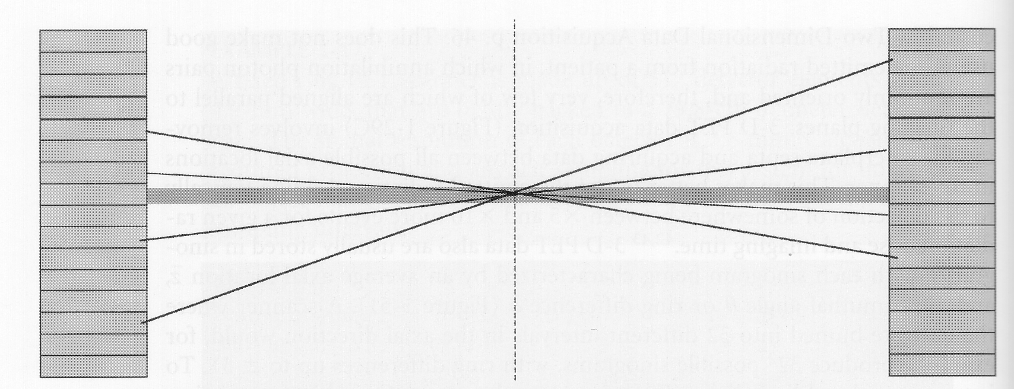
3D image reconstruction
Chapter 3.16
Data are reduced to a set of parallel 2D sinograms by rebinning all sinograms with same z value into the same sinogram
z₈
z₁
z₇
z₂
z₆
z₃
z₅
z₄
$z_{1}+z_{5}=z_{2}+z_{6}=z_{3}+z_{7}=$ $z_{4}+z_{8}$
▶︎ Reconstruction of N 2D sinograms

Slide 17
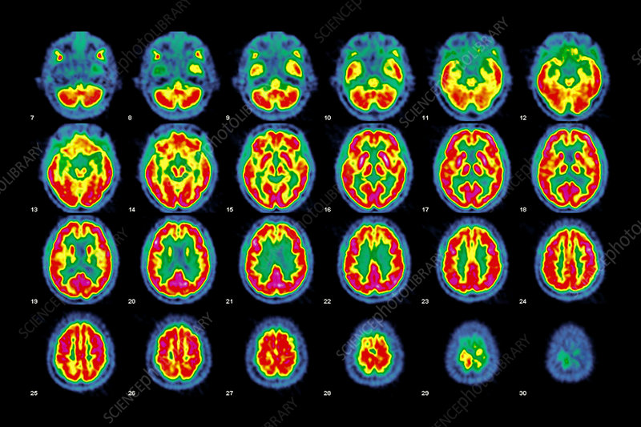
3D image reconstruction

Slide 18
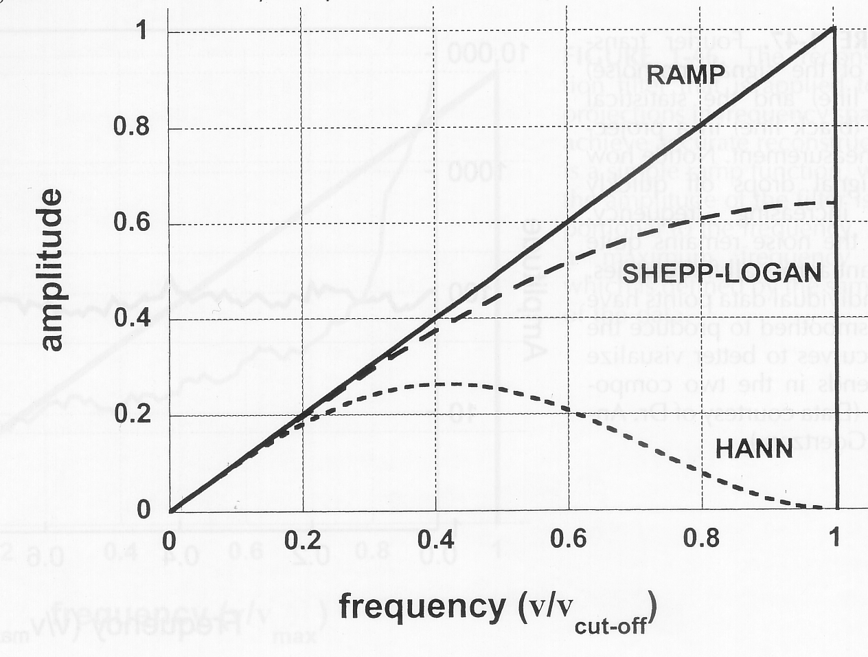
Image noise reduction
Chapter 3.19
see e.g. exercise XCT #2

Slide 19
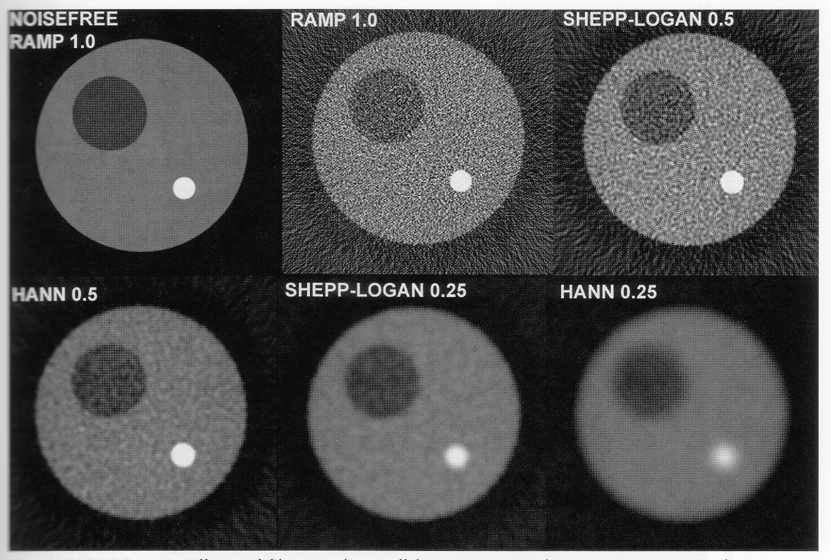
Image noise reduction

Slide 20
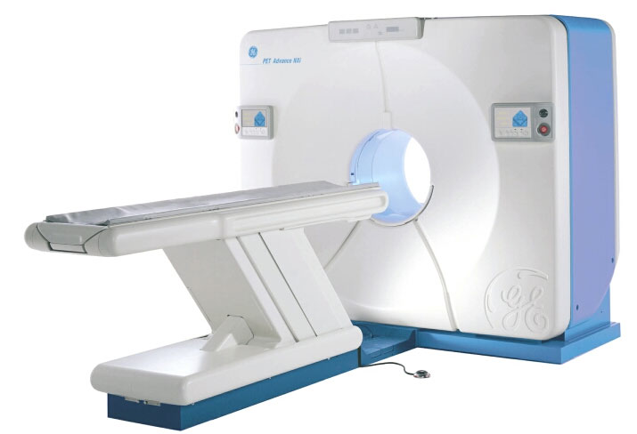
Clinical PET scanner

Slide 21
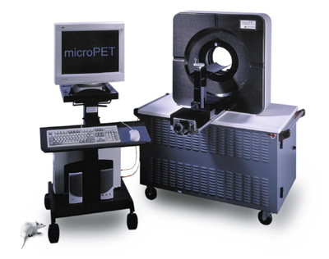
Animal PET scanner

Slide 22
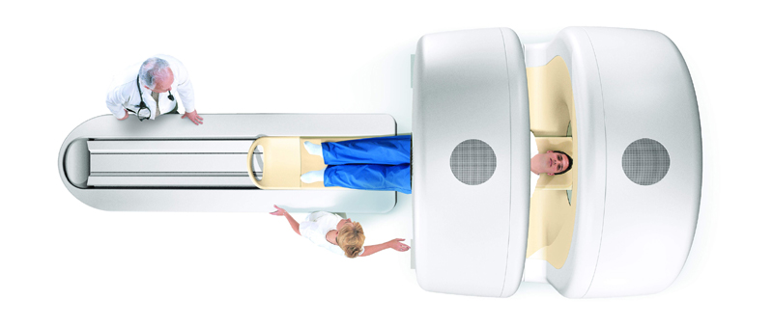
PET/CT scanner

Slide 23
Total body PET scanner

Slide 24
Radiotracer Production

Slide 25
SPECT radioisotopes
Chapter 3.3
Radioisotope | Energy (keV) | Half-life | Production
⁶⁷Ga | 93, 185, 300 | 3.3d | cyclotron
^{99m}Tc | 140 | 6h | generator
¹¹¹In | 173, 247 | 67h | cyclotron
¹²³I | 160 | 13h | cyclotron
¹³³Xe | 81 | 5.2d | reactor
²⁰¹Tl | 60, 83 | 73h | cyclotron
Notes:
TI thalium

Slide 26
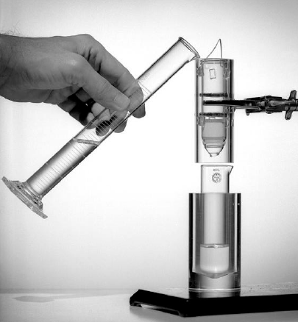
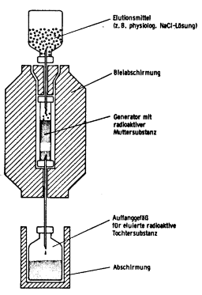
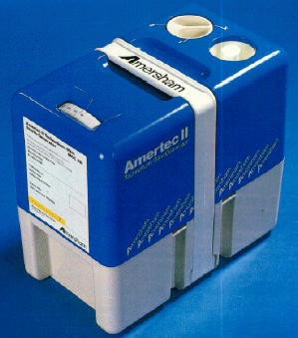
Technetium generator
Chapter 3.4
Eluate: NaCl
Lead screen
Generator:
Mother nuclide (⁹⁹Mo)
Immobilized on alumina
(Al₂O₃)
Collection vial for
daughter nuclide
(^{99m}Tc)
Lead screen

Slide 27
Technetium generator
99
42
(67 h) Mo
β⁻
82%
99m
43
(6 h) Tc
142 keV
140 keV
1% 99%
γ (140 keV)
99
43
(2⋅10⁵ y) Tc
β⁻
99
44
Ru

Slide 28
Technetium generator
k_{Mo}
k_{Tc}
2.90⋅10⁻⁶s⁻¹
3.20⋅10⁻⁵s⁻¹
Kinetic equations:
Solution:
Radioactivity of ^{99m}Tc:

Slide 29
Technetium generator
Time (h)

Slide 30
Technetium tracers
Radiolabel | Ligand | Application
^{99m}TcO₄-Na | Sodium pertechnate | Thyroid function
^{99m}Tc-HSA | Human serum albumine | Blood pool, cardiac function
^{99m}Tc-HSA | Human serum albumine (microspheres) | Regional perfusion, vascular patency
^{99m}Tc-MIBI | 2-methoxy-isobutylisonitril | Myocardial function
^{99m}Tc-HMPAO | Hexamethyl-propylenaminoxim | Cerebral perfusion
^{99m}Tc-HEDP | Hydroxyl-ethylene-diphosphonate | Bone metabolism / formation
^{99m}Tc-MDP | Methylene-diphosphonate | Bone metabolism / formation
^{99m}Tc-DTPA | Diethylene-triamine-tetraacetate | Kidney function, lung function

Slide 31
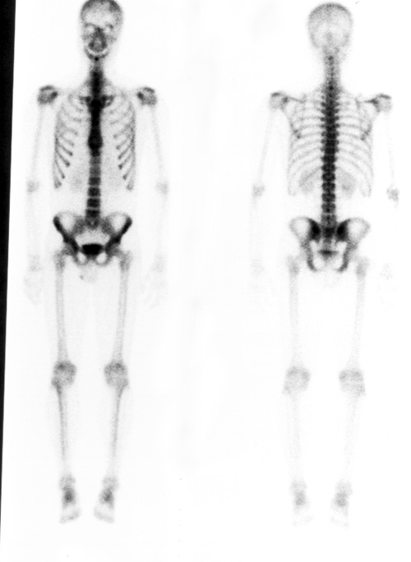
SPECT imaging of bone

Slide 32
PET radioisotopes
Chapter 3.14
Radionuclide | Half-life | E_{max} (MeV) | e⁺ decay (%)
¹¹C | 20.4 min | 0.96 | 100
¹³N | 10 min | 1.20 | 100
¹⁵O | 2 min | 1.73 | 100
¹⁸F | 110 min | 0.63 | 97
²²Na | 2.6 y | 0.55 | 90
⁶²Cu | 9.7 min | 2.93 | 97
⁶⁴Cu | 12.7 h | 0.65 | 29
⁶⁸Ga | 67.6 min | 1.89 | 89
⁷⁶Br | 16.2 h | Various | 56
⁸²Rb | 1.3 min | 2.60, 3.38 | 96
¹²⁴I | 4.2 d | 1.53, 2.14 | 23

Slide 33

Production of ¹⁸F radionuclide
https://www.youtube.com/watch?v=zD1fnNAmAPk

Slide 34
Properties of ¹⁸F radionuclides
Lifetime 110 min
Lifetime reasonably long for chemical synthesis
Lifetime long enough to allow for shipping of labeled compound
¹⁸F PET does not require on-site cyclotron
Studies can be repeated in relatively short time intervals
but
Pharmacokinetics different from native, endogenous compound

Slide 35
PET radioisotopes
Chapter 3.14
Radionuclide | Half-life | E_{max} (MeV) | e⁺ decay (%)
¹¹C | 20.4 min | 0.96 | 100
¹³N | 10 min | 1.20 | 100
¹⁵O | 2 min | 1.73 | 100
¹⁸F | 110 min | 0.63 | 97
²²Na | 2.6 y | 0.55 | 90
⁶²Cu | 9.7 min | 2.93 | 97
⁶⁴Cu | 12.7 h | 0.65 | 29
⁶⁸Ga | 67.6 min | 1.89 | 89
⁷⁶Br | 16.2 h | Various | 56
⁸²Rb | 1.3 min | 2.60, 3.38 | 96
¹²⁴I | 4.2 d | 1.53, 2.14 | 23

Slide 36
Production of ¹¹C radionuclide
α
(2p, 2n)
e⁺ + ν
¹⁴N + p [¹⁵F ]
(7p, 7n) (8p, 7n)
¹¹C
(6p, 5n)
<< 1s
¹¹B
(5p, 6n)
20 min
Proton
capture
Proton source:
cyclotron
Metastable
nucleus
(t_{1/2} << 1s)
Positron
emitter
Stabilization by
positron emission
Chemical
synthesis
Stable
nucleus
Stabilization by emission of α-particle

Slide 37
Properties of ^{11C} radionuclides
All organic compounds contain C and can be labeled in principle
Pharmacokinetic properties identical to that of ‚cold‘ parent compound
Studies of drug biodistribution / PK
Receptor affinity identical to that of parent compound
but
Short half life (20 min)
Chemical synthesis difficult due to time constraints

Slide 38
Quantitative PET Analysis

Slide 39
Quantitative PET – definitions
Injected dose per gram of tissue:
c_{t} tissue concentration
v_{t} volume of tissue ROI
m_{t} mass of tissue ROI
D_{inj} injected dose
Standardized Uptake Value (SUV):
M : Body mass

Slide 40
Quantitative PET – receptor binding
PET radiotracer
Ligand
Receptor
Cell
Cell
Receptor
Ligand

Slide 41
Quantitative PET – receptor binding
Receptor Binding: L + R ↔ RL Equilibrium constant: (principle of microreversibility)
Mass conservation for receptor:
yields
or the receptor binding
and the Scatchard equation
(L: Ligand, R: Receptor)

Slide 42
Quantitative PET – receptor binding
Binding plot
Scatchard plot
[RL]/[R_{t}]
[L]
[RL]/[R_{t}]
K_{d}
for [RL]<<[R_{T}]
log[L]
B_{max}: maximum binding capacity

Slide 43
Quantitative PET – tracer extraction
Tracer extraction from capillaries
F
F
c_{a}
c_{v}
The amount of tracer extracted from capillaries depends on capillary surface S, the vascular permeability P and the blood flow F:
Renkin-Crone equation

Slide 44
Quantitative PET – volume distribution
Distribution volume
tissue
c_{t}
v₁
v_{t}
blood
c_{b}
Tracer experiment
M: total amount of tracer
tissue
c_{t}
blood
c_{b}

Slide 45
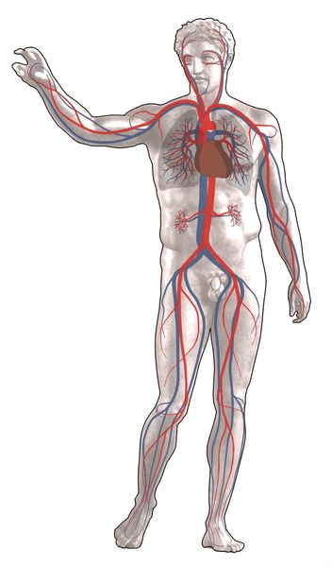
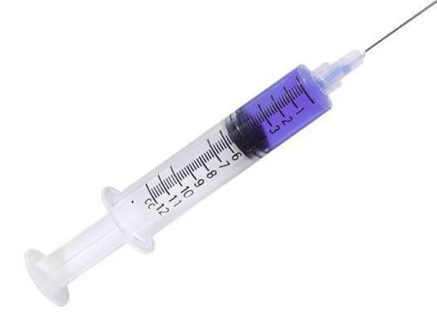

Clicker Activity (5 min)
After administration of 1 μg/kg of a tracer into a patient of 70 kg body mass, an average blood concentration of 1.4 μg/l is measured. What is the distribution volume?
• 5 l
• 500 ml
• 50 l
• 10 l

Slide 46
Quantitative PET – compartment modeling
Blood
Target organ
‚tissue-reservoirs‘

Slide 47
Quantitative PET – modeling of receptor binding
Tracer fraction in tissue
compartments
p: plasma
f: free (in tissue)
ns: non-specific bound
b: bound
PET activity at time t:
i = p, f, ns, b
v_{i} fractional volume of compartment

Slide 48
Quantitative PET – modeling of receptor binding
≈
Equilibrium free / non-specifically bound tracer instantaneous:
Kinetic equations:
with rate constants:
Renkin-Crone:

Slide 49
Quantitative PET – tracer kinetics for receptor binding
Solution for compartment expressing receptor:
with coefficients
Solution for compartment not expressing receptor:

Slide 50
Quantitative PET – tracer binding example
Compartment expressing receptor
c_{t}(t)
Compartment not expressing receptor
k₁=1min⁻¹, k₂=0.1min⁻¹, k₃=1min⁻¹ and 0.5min⁻¹, k₄=0.01min⁻¹

Slide 51
Quantitative PET – cell energy metabolism

Slide 52
Quantitative PET – cell energy metabolism
Native glucose utilization
CH2OPO32
6
6
hexokinase
6
isomerase
4
CH2OH
4
CH2OPO32-
4
5
O
OH
O
HO
5
HO
5
O
HO
HO
2
1
OH
HO
2
1
OH
HO
2
3
OH
3
OH
3
CH2OH
Glucose (G)
Glucose -6-phosphate(G6P)
1
Fructose-6-phosphate(G6P)
FDG PET deoxyglucose utilization
6
6
4
CH2OH
4
CH2OPO32-
Ligand trapped
in cells as FDG6P
HO
5
O
HO
5
O
HO
2
1
OH
HO
1
OH
X
3
2
18F
3
18F
[18F]-2-fluoro-2-
deoxyglucose (FDG)
FDG6P

Slide 53
Quantitative PET – FDG compartment models
-
-

Slide 54
Quantitative PET – FDG compartment models
Total tracer concentration in tissue
(assume v_{p}<<v_{t}≈V)
Kinetic equations for tracer:
Solution:

Slide 55
Quantitative PET – FDG compartment models
Metabolic rate of FDG:
Metabolic rate of glucose (glucose utilization):
Lumped constant (ca. 0.6 in humans)
Correction factor to translate measured reaction rate for
FDG to that for glucose

Slide 56
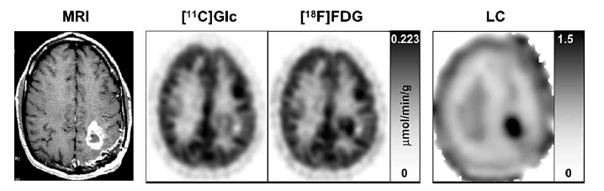
Quantitative PET – FDG lumped constant
Patient with brain glioma. The panels include calculated metabolic rate for the true tracer [1-¹¹C]glucose and the analog FDG. The two PET images were divided (PET_{FDG}/PET_{glc}) on a pixel-by-pixel basis to provide an image of regional variation of the lumped constant LC.
Krohn et al (2005) Nucl Med Biol. 32:663

Slide 57
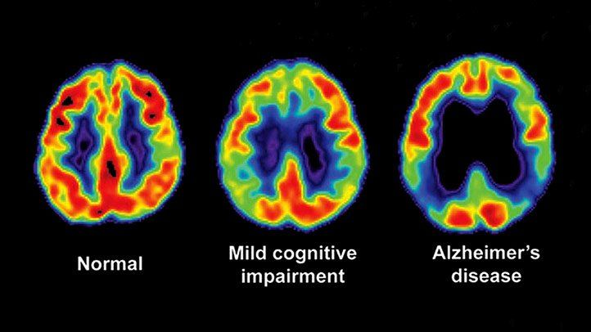
Application – FDG PET of Alzheimer disease
Reduced FDG PET activity in Alzheimer patient compared to age-matched control

Slide 58
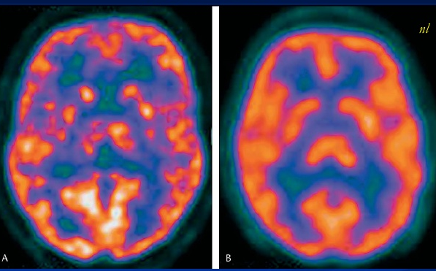
Application – FDG PET of cocaine abuse
Cocaine abuse
Normal

Slide 59
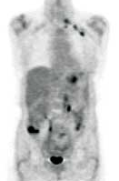
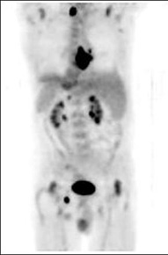
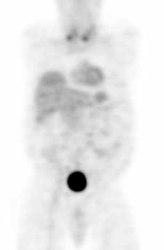
Application – FDG PET of cancer metastases

Slide 60
“The most important slides”

Slide 61
Quantitative PET – tracer kinetics for receptor binding
Coupled differential equations:
Solution applying basis transformation c → y
Decoupling by searching eigenvectors:
Eigenvalues:

Slide 62
Quantitative PET – competition cold / hot ligand
Modified tracer kinetics in the presence of a cold drug:
Two ligands (drug, tracer) competing for the same receptor
Kinetic equations for
‚hot‘ ligand
‚cold‘ ligand

Slide 63
Quantitative PET – competition cold / hot ligand
The two equation systems are coupled through the mass balance of the receptor
[RL*] + [RL] + [R] = [R_{t}]
* hot ligand
or
Receptor occupancy for cold drug:
Competition (drug injected prior to tracer experiment)
Displacement (drug injected during tracer experiment)
B_{max}
B_{max}
B’_{max}
B’_{max}

Slide 64
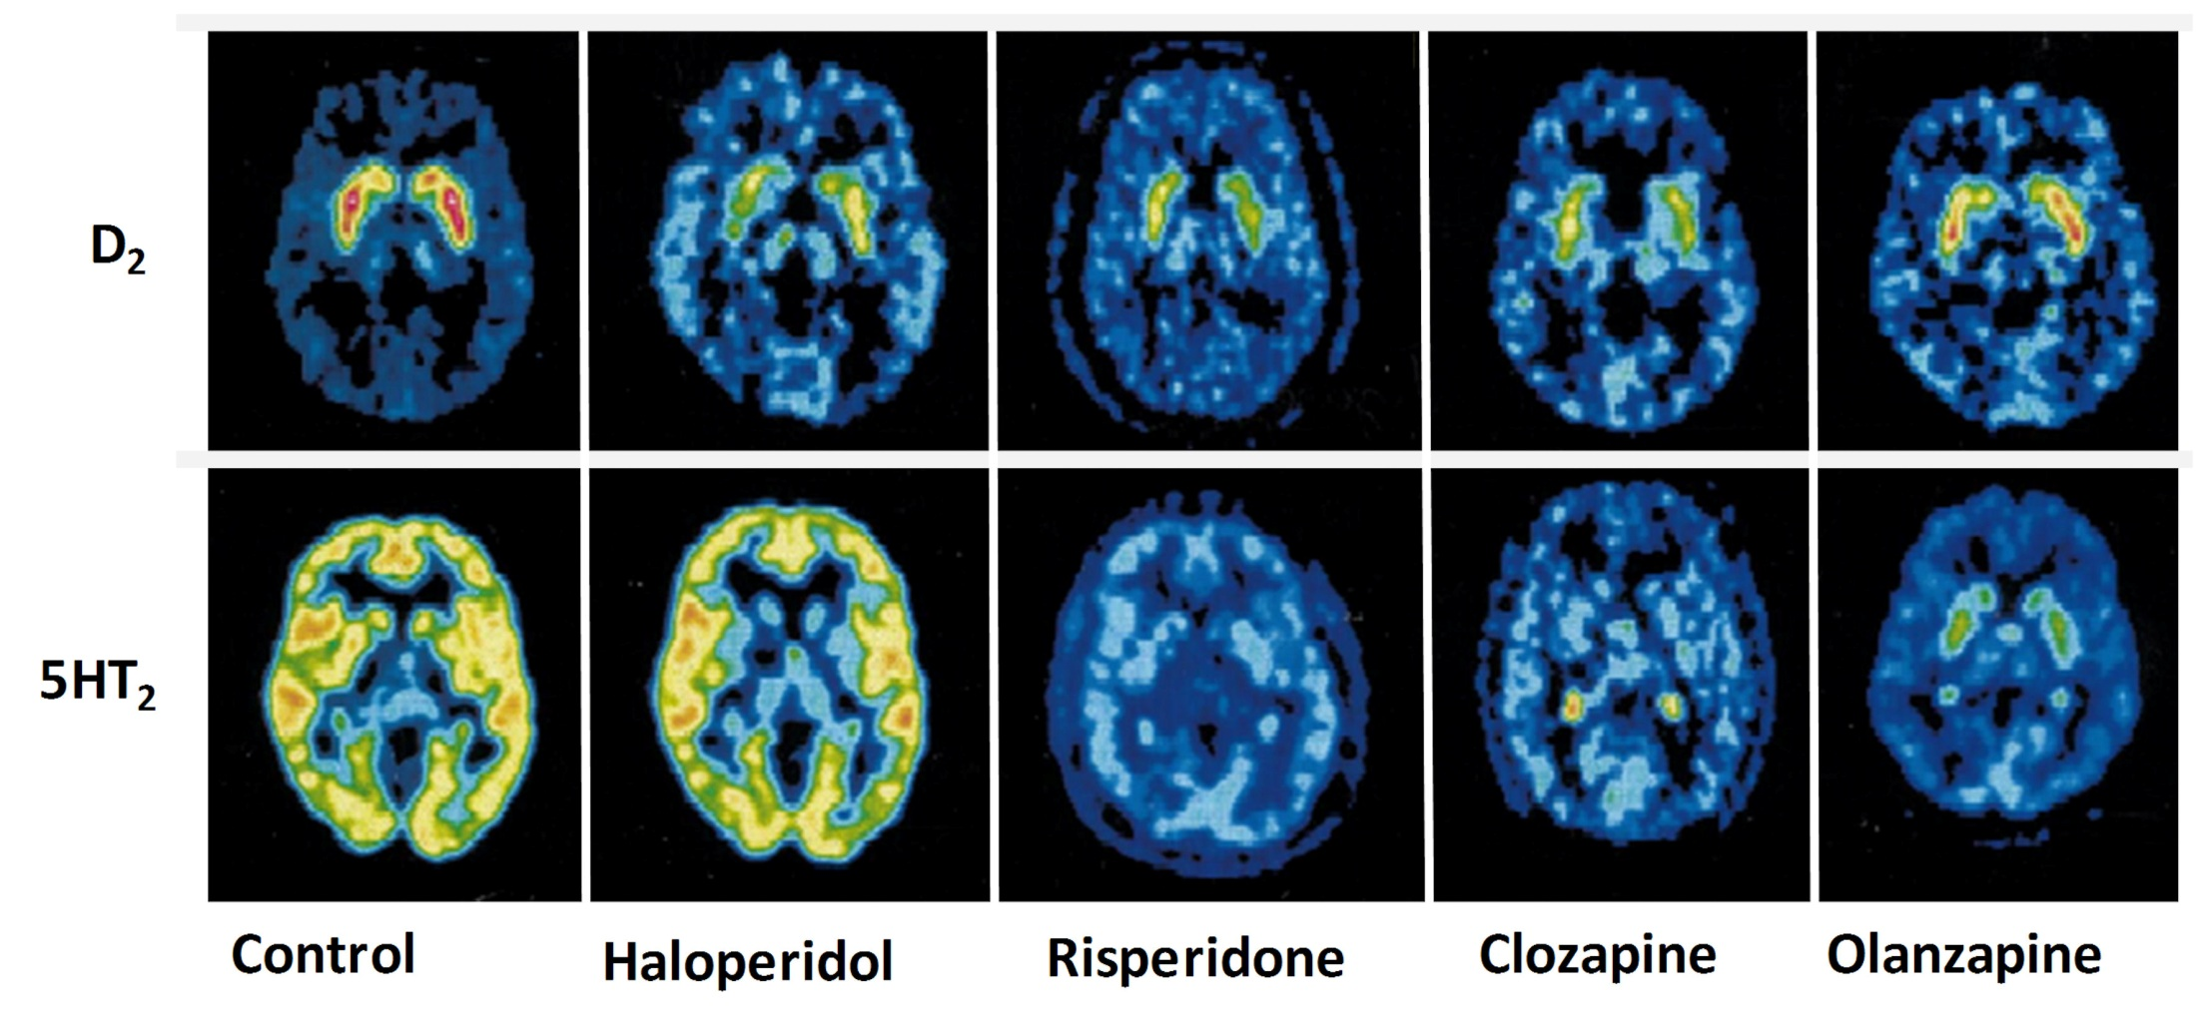
Quantitative PET – competition cold / hot ligand
B_{max}(D₂)
B’_{max}(D₂;H)
B’_{max}(D₂;R)
B’_{max}(D₂;C)
B’_{max}(D₂;O)
B’_{max}(C)
B_{max}(5HT₂)
B’_{max}(5HT₂;H)
B’_{max}(5HT₂;R)
B’_{max}(5HT₂;C)
B’_{max}(5HT₂;O)
Notes:
Schizophrenic patient under various antipsychotic drugs. Interaction with dopamine D2 receptors

Slide 65
Flortaucipir PET – detection of brain plaques
https://www.nejm.org/doi/full/10.1056/NEJMoa1900757
Notes:
PET maps superimposed on MRI brain scans show voxels with higher regional:cerebellar gray-matter flortaucipir standard uptake value ratios (SUVRs) among former National Football League (NFL) players.
We used flortaucipir positron-emission tomography (PET) and florbetapir PET to measure deposition of tau and amyloid-beta, respectively, in the brains of former National Football League (NFL) players with cognitive and neuropsychiatric symptoms and in asymptomatic men with no history of traumatic brain injury. Automated image-analysis algorithms were used to compare the regional tau standardized uptake value ratio (SUVR, the ratio of radioactivity in a cerebral region to that in the cerebellum as a reference) between the two groups and to explore the associations of SUVR with symptom severity and with years of football play in the former-player group.

